Slide 1
Building Data Bound Web User Interfaces
(Section 8)

Slide 2
The art of laying out pages
Component | Description
af:panelFormLayout | Arranges items in columns or grids.
af:panelBorderLayout | Places items in fixed, peripheral areas around a central area.
af: panelStretchLayout | Enables automatic component stretching in your pages. This contains top, bottom, start, center, and end facets to hold child components.
af:panelSplitter | Enables automatic component stretching in your pages. This divides a region into two parts (the first facet and the second facet) where you can place contents.
af:panelDashBoard | Arranges child components column- wise.
af:panelAccordion | Creates collapsible panes.
af:panelTabbed | Creates stacked tabs.
Component | Description
af:panelBox | Provides a titled box which can contain child components.
af:decorativeBox | Provides a decorative box for the child components.
af:showDetail | Hides and displays groups of content through the toggle icon.
af:panelGroupLayout | Enables automatic scroll bars in your pages, and arranges items horizontally or vertically.
af:panelCollection | Adds menus, toolbars, and status bars to data aggregation components such as tables, trees, and tree tables.
af:panelHeader | Creates titled sections and subsections.
af:panelList | Creates styled lists and content boxes.
af:panelGridLayout | Arranges components in columns or grids using af:gridRow and af:gridCell.
af:spacer | Adds a blank space between components.
af:separator | Adds divider line between components.

Slide 3

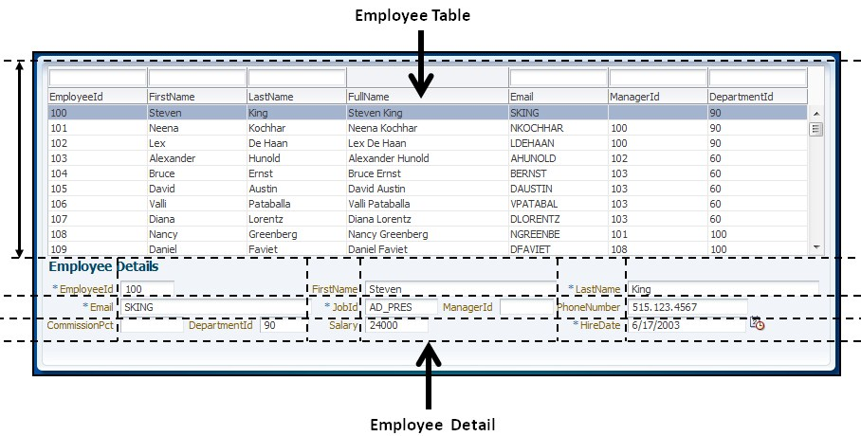
Organizing page contents

Slide 4
Organizing page contents
<af:panelStretchLayout id="psl1" bottomHeight="150px">
<f:facet name="bottom"/>
<f:facet name="center"/>
<f:facet name="start"/>
<f:facet name="end"/>
<f:facet name="top"/>
</af:panelStretchLayout>
The facet for a JSF component represents a named section within the container components. It allows you to add more characteristics to the component.

Slide 5
Adding actions to your page
JSF allows you to execute business logic in response to user actions on the UI component at runtime. These events are broadly termed as application events.
You will use ADF Faces command components such as af:commandButton, af:commandLink, and af:commandImageLink to invoke any business service methods or to perform page navigation

Slide 6
Choosing between the managed bean method and the data control method as event handlers
The managed bean is the code-behind class for an ADF Faces (JSF) page. All your client's specific logic, such as reading a selected row in UI table components, or checking the status of UI components, and so on, should be coded in a managed bean
A data control typically acts as a wrapper over your business service implementation. Ideally business service implementation should be independent of the view layer.

Slide 7
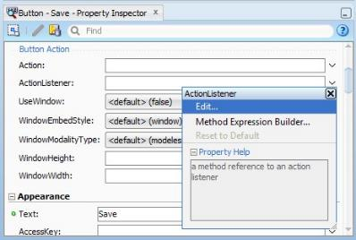
Using managed bean methods as event handlers
Creates Java bean class with a method
Defines an entry for the new bean in adfc-config.xml or in the task flow XML file as appropriate
Generates an EL expression for the binding component actionListener attribute in the page with the method in the managed bean

Slide 8
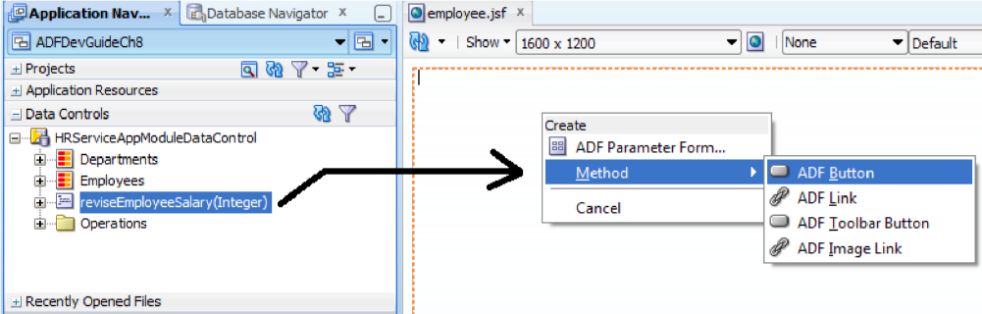
Using data control methods as event handlers

Slide 9
Using data control methods as event handlers
In Page Definition , the Edit Action Binding dialog allows you to specify values for parameters appearing in the method. The possible parameter options are as follows:
Final
Optional
Mandatory
When you finish dropping a method on the page, IDE creates the following items:
The IDE creates the <af:commandButton> component in the JSF page with the appropriate EL binding for the actionListener attribute.
IDE also generates a <methodAction> binding in the page definition file for accessing the method that is dropped from the Data Controls panel.

Slide 10
Building data bound table UIs
The table UI is one of the very popular UI components for presenting a collection of rows to end users. In general, displaying data collection on a table UI involves the following tasks:
Invoking business services for reading data collection
Populating the UI with retrieved collection
When you build a table component by dragging and dropping a data collection on a page, the IDE generates the following:
Code for <af:table> component in the JSF page
Binding definition for the table in the page definition file
An executable iterator binding
A tree binding definition that describes the attributes of a row present in the collection.

Slide 11
Deleting a row
To add a delete functionality, perform the following steps:
Go to the Data Controls panel and select the data collection used for building the table, then expand the Operations node.
Drag the Delete operation and drop it on the page.

Slide 12
Committing changes
To add the save functionality, drag the Commit operation from Data Controls and drop it on a page as an action component by choosing the appropriate component displayed in the context menu.

Slide 13
Declaratively reading the attribute value from the currently selected row
It is very common that when a row is selected in a table, you may want to update other fields in the UI or call some specific operations with attributes from the selected row.
In Page Definition :
<attributeValues IterBinding="DepartmentsIterator" id="DepartmentName">
<AttrNames>
<Item Value="DepartmentName"/>
</AttrNames>
</attributeValues>
In Jsf Page :
#{bindings.DepartmentName.inputValue}

Slide 14
Building data bound master-detail UIs
Building a master-detail data model
Building a master-detail UI
What happens at runtime in the master-detail UI?
Master-detail coordination is enabled through a view link instance (ViewLinkUsage) in the application module that connects the appropriate master and detail view object instances. When you select a master row, the framework eagerly coordinates the detail collection with the master row by re-executing the detail view object.

Slide 15
Building a data bound tree table UI
The tree table displays hierarchical data in tabular form by combining both tree and table UI functionalities in one component.
All the view objects participating in the tree hierarchy must be linked through the view link definitions. While defining view links, you must make sure that the child accessor attribute(s) are enabled on all the parent view objects participating in the hierarchy.
Creating a tree table UI …

Slide 16
What happens when you drop a data collection as a tree table on a page?
Code for the <af:treeTable> component in the JSF page with all generic properties defaulted with values from the model definition (the topmost parent view object definition)
Binding the definition for the tree table which includes an executable iterator binding and a tree control binding definition

Slide 17
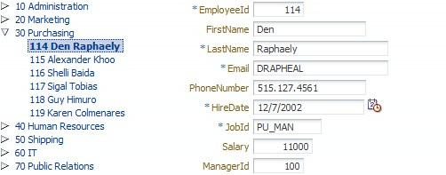
Synchronizing UIs using the target data source
Whenever an employee node selection changes in the tree, the detailed parameter form on the right-hand side refreshes to reflect the new selection. The tree binding definition has declarative support for building such screens, which may help you to synchronize other parts of the page with the selection of a node in the tree.

Slide 18
What happens at runtime in the target data source?
Whenever the row selection changes in the source iterator, the binding layer will try to refresh target iterators by invoking the setCurrentRowWithKey(String stringKey) method with the Key attribute(s) of the selected row of the source iterator. All the UI elements bound to the target iterator will change during the subsequent render response phase in the same request processing cycle.

Slide 19
Building data bound query search forms
The Oracle ADF framework has out of the box support for building feature rich search panels when you use the view object for querying the data source. In fact the implementation is much easier than you thought.
ADF uses the model-driven approach for building query components whose query model is derived from the view criteria that you defined in a view object.

Slide 20
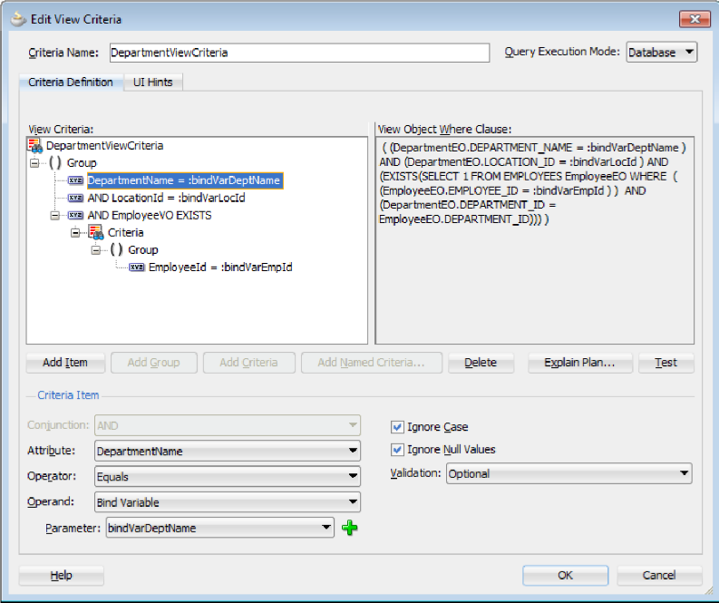
Building the view criteria

Slide 21
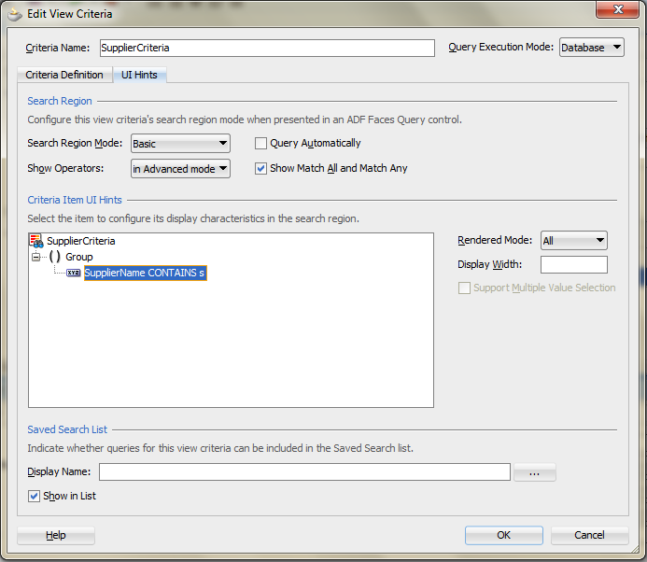
Using UI hints to control the display for a query component

Slide 22
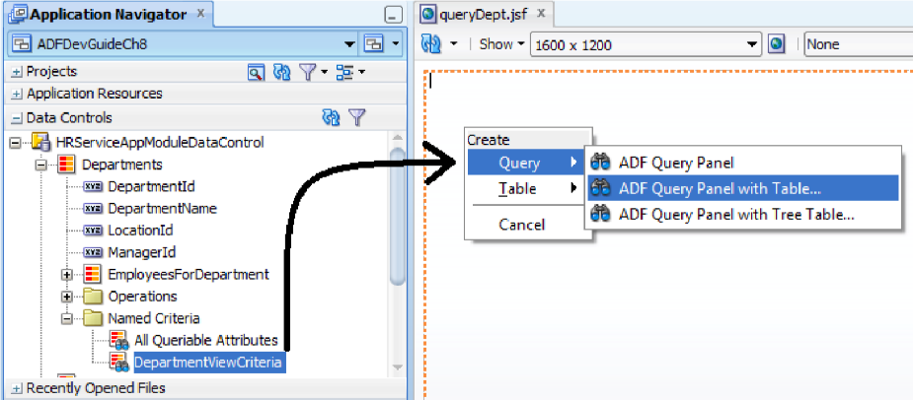
Building a search UI
<searchRegion Criteria="DepartmentViewCriteria" Customizer=
"oracle.jbo.uicli.binding.JUSearchBindingCustomizer"
Binds="DepartmentsIterator" id="DepartmentViewCriteriaQuery"/>

